Slide 1

All About Attendance in PowerSchool
Paul Kang
April 13, 2015

Slide 2
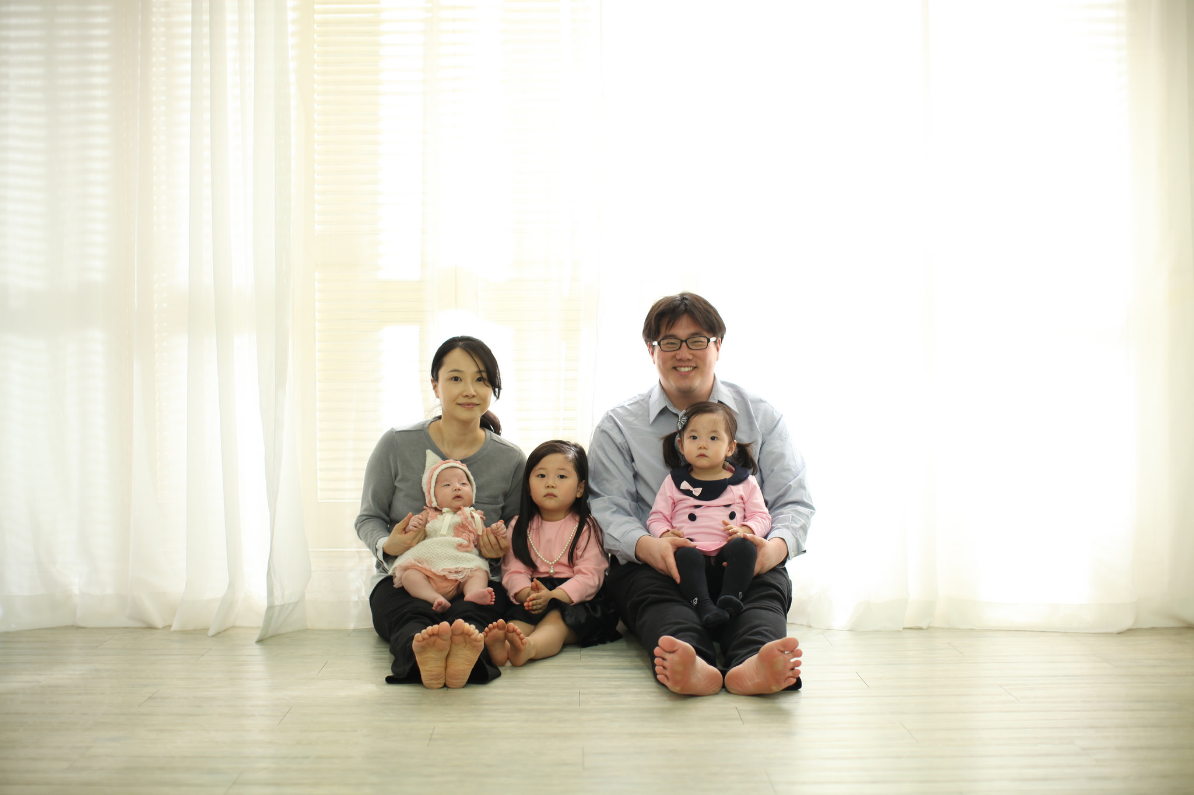
Hoo is Paul Kang?
Love: Jesus, family, learning, reading, creating art, technology, photography, anime, manga, romantic comedies and action movies
Korean American
PS Admin for 5 Years

Slide 3
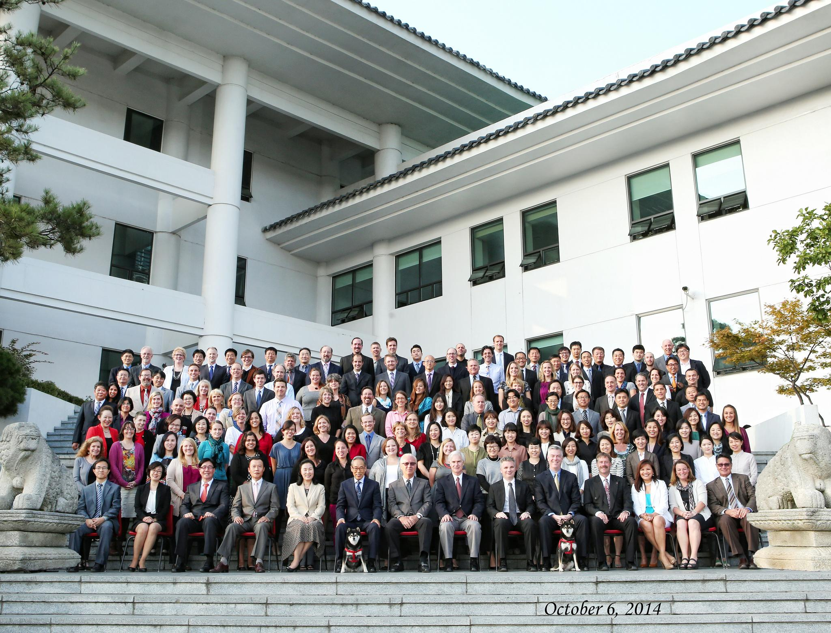
Seoul International School (SIS)
Founded in 1973
1,100 Students from JK – 12th
100 Teachers, 150 Administrative and Support Staff
Located in Seongnam, South Korea
98% ethnic Korean, variety of citizens
Used PS for 5 Years – Version 8.1.0
Highly academic and competitively focused

Slide 4
Agenda
Introductions
What attendance data is important to you?
What can PowerSchool do with Attendance?
What SIS does with attendance?

Slide 5
Introductions
What’s your name?
What’s your role at school?
What’s one thing you would like to learn about attendance with PowerSchool?

Slide 6
What Can PowerSchool do with Attendance?
PowerSchool is primarily for US Public Schools
Tracking and Notifications (District and School)
  Send email after X number of unexcused absences/sick days
Five Types of Attendance: Daily, Meeting, Interval (record by each hour), Time (independent study/work experience), and Concurrently (one teacher teaches several classes at once)

Slide 7
What Can PowerSchool do with Attendance? Part 2
Setup: Years & Terms,
Days, Periods,
Attendance Preferences,
Full Time Equivalency (FTE) Codes,
Attendance Conversions, Bell Schedules, Calendar,
Reporting Segments, Attendance Code Categories,
Attendance Codes, Schedules, Schedules and Section Attendance Settings, Class Exclusions

Slide 8
What Can PowerSchool do with Attendance? Part 3
Recording Attendance:
  Mark/Change Single Attendance
  Mark/Change Single Student’s Attendance in blocks
  Mark/Change groups of students
Present, Tardy, and Excused are defaults settings
Attendance Code Categories (Depends on school’s administration)

Slide 9
What Can PowerSchool do with Attendance? Part 4
Attendance can be taken by teachers and anyone you give access (e.g. secretaries)
Reporting
  Functions Attendance:
    Teacher Attendance Submission Status (Who hasn’t taken attendance yet?)
    Absentee Report (Who’s absent today?)
    Perfect Attendance Search
    Attendance Verification (How important is your attendance data?)

Slide 10
The Real Question
What is your school’s philosophy with attendance?
What data do you really want?
Do you have support or can make decisions with your administrators

Slide 11
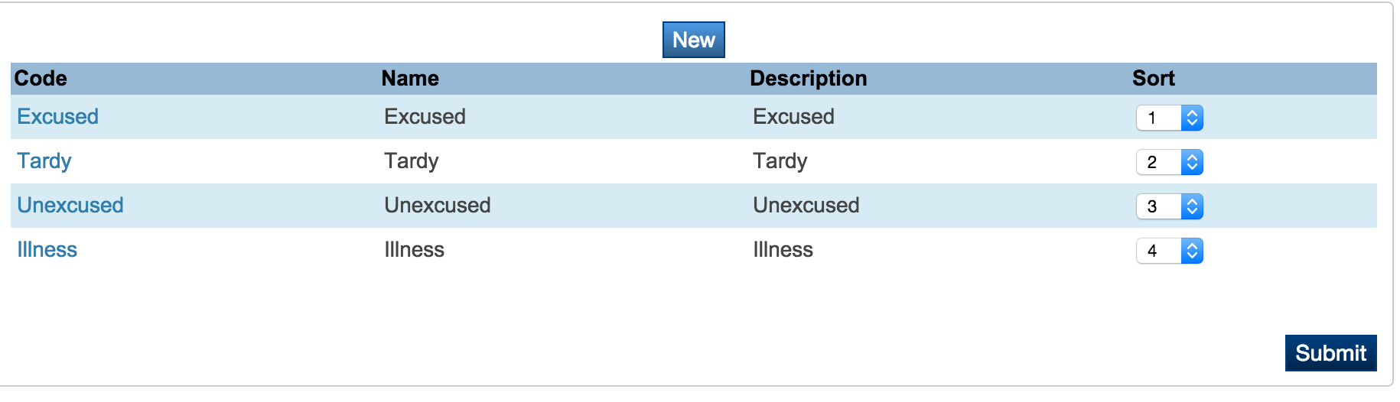
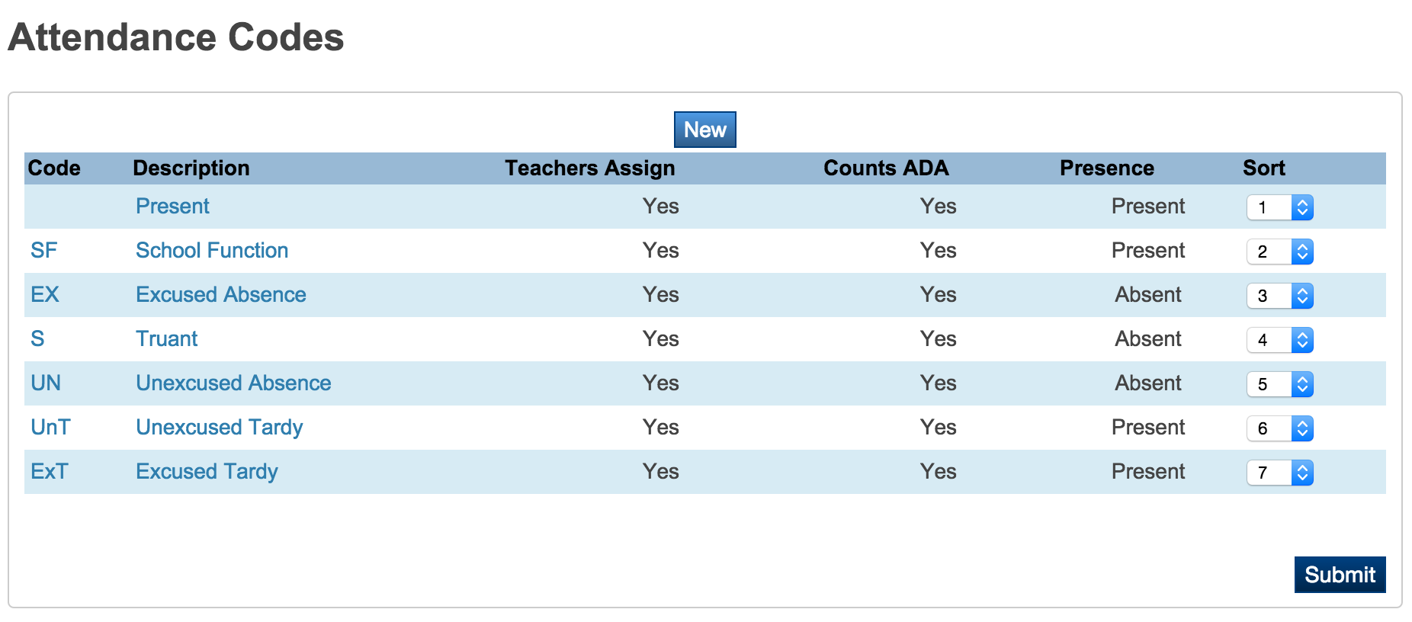
What SIS Does with Attendance?

Slide 12
What SIS Does with Attendance?
Custom Reports Bundle Attendance 4.0.2 Module from PowerDataSolutions.org
We don’t really have an attendance problem

Slide 13
Where to find additional help?
Help Documentation inside PowerSchool
PowerSource
PSUG National – Biggest PSUG Group in the world
Pearson Technical Support International Phone call
PS Conferences – like this one

Slide 14
Connect with Paul
Email: kangp@siskorea.org
LinkedIn:https://www.linkedin.com/in/hookang

Slide 15
Any Questions? Comments?
Please send me a quick email with your opinion of this class?
  kangp@siskorea.org
  Subject line: Attendance
  What’s one thing that you can take away from today?
  What’s one thing Paul can do to improve this presentation?
  Would you recommend this class to your colleagues?

Slide 16

Thank You

